Slide 1
Storing & Indexing Elements
Brief overview of the concepts
Binary Search Tree (BST)
Hashing
Perfect Hashing
Universal Hashing
Open Hashing
Neighbourhood Numbers are Hashed in Neighbourhood only? (Yes/No)
Rehashing
Concurrent hash table
Cuckoo hashing

Slide 2
Binary Search Tree

Slide 3
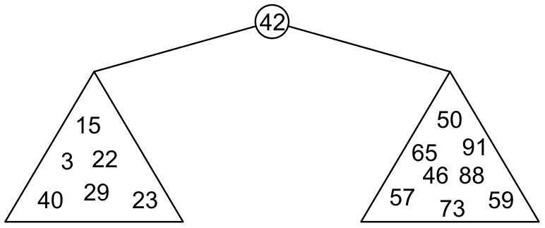
Binary Search Trees
Graphically, we may show the relationship as
Each of the two sub-trees will themselves be binary search trees

Slide 4
Definition
Thus, we define a non-empty binary search tree as a binary tree with the following properties:
The left sub-tree (if any) is a binary search tree and all elements are less than the root element, and
The right sub-tree (if any) is a binary search tree and all elements are greater than the root element

Slide 5
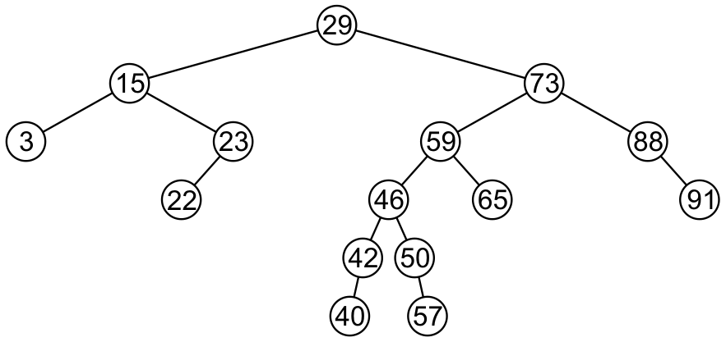
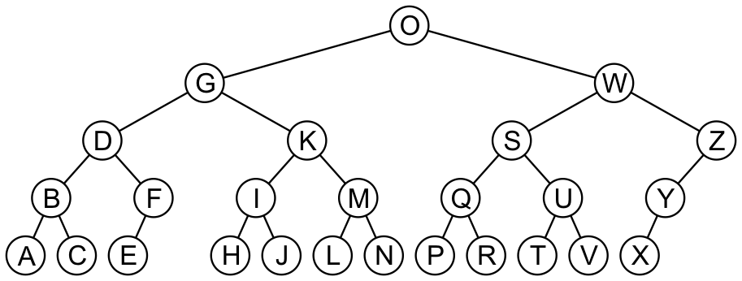
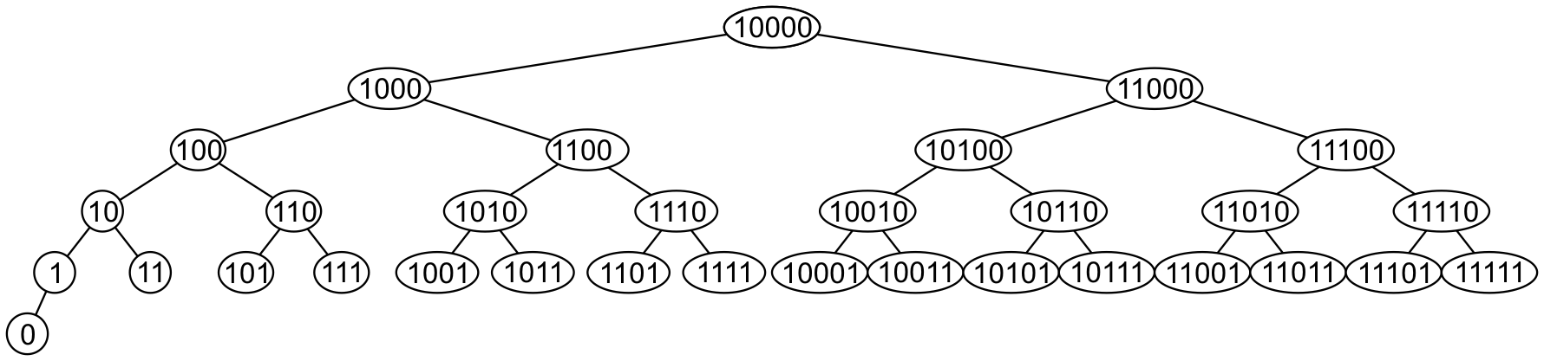
Examples
Here are other examples of binary search trees:

Slide 6
46 | 23 | 40 | 65 | 15 | 88 | 57 | 3 | 50 | 91 | 73 | 59 | 22 | 29 | 42
29 | 73 | 88 | 15 | 23 | 22 | 59 | 3 | 91 | 46 | 50 | 42 | 40 | 57 | 65
3 | 15 | 22 | 23 | 29 | 40 | 42 | 46 | 50 | 57 | 59 | 65 | 73 | 88 | 91
3 | 50 | 46 | 29 | 40 | 65 | 15 | 42 | 57 | 22 | 23 | 59 | 73 | 91 | 88

Slide 7
46 | 23 | 40 | 65 | 15 | 88 | 57 | 3 | 50 | 91 | 73 | 59 | 22 | 29 | 42
29 | 73 | 88 | 15 | 23 | 22 | 59 | 3 | 91 | 46 | 50 | 42 | 40 | 57 | 65
3 | 15 | 22 | 23 | 29 | 40 | 42 | 46 | 50 | 57 | 59 | 65 | 73 | 88 | 91
3 | 50 | 46 | 29 | 40 | 65 | 15 | 42 | 57 | 22 | 23 | 59 | 73 | 91 | 88

Slide 8
46 | 23 | 40 | 65 | 15 | 88 | 57 | 3 | 50 | 91 | 73 | 59 | 22 | 29 | 42
29 | 73 | 88 | 15 | 23 | 22 | 59 | 3 | 91 | 46 | 50 | 42 | 40 | 57 | 65
3 | 15 | 22 | 23 | 29 | 40 | 42 | 46 | 50 | 57 | 59 | 65 | 73 | 88 | 91
3 | 50 | 46 | 29 | 40 | 65 | 15 | 42 | 57 | 22 | 23 | 59 | 73 | 91 | 88

Slide 9
46 | 23 | 40 | 65 | 15 | 88 | 57 | 3 | 50 | 91 | 73 | 59 | 22 | 29 | 42
29 | 73 | 88 | 15 | 23 | 22 | 59 | 3 | 91 | 46 | 50 | 42 | 40 | 57 | 65
3 | 15 | 22 | 23 | 29 | 40 | 42 | 46 | 50 | 57 | 59 | 65 | 73 | 88 | 91
3 | 50 | 46 | 29 | 40 | 65 | 15 | 42 | 57 | 22 | 23 | 59 | 73 | 91 | 88

Slide 10
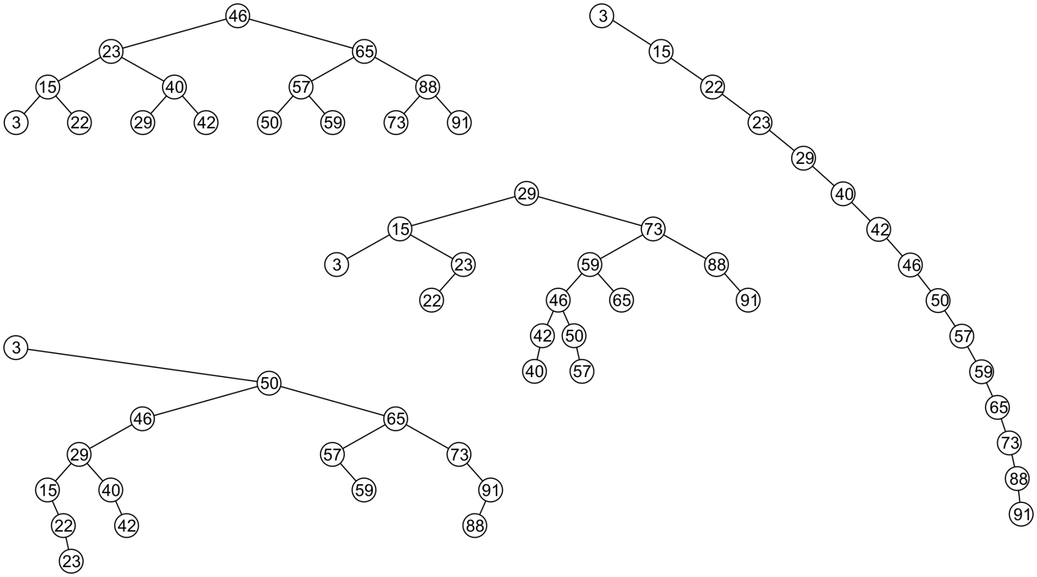
Examples
All these binary search trees store the same data

Slide 11
Duplicate Elements
We will assume that in any binary tree, we are not storing duplicate elements unless otherwise stated
In reality, it is seldom the case where duplicate elements are stored as separate entities

Slide 12
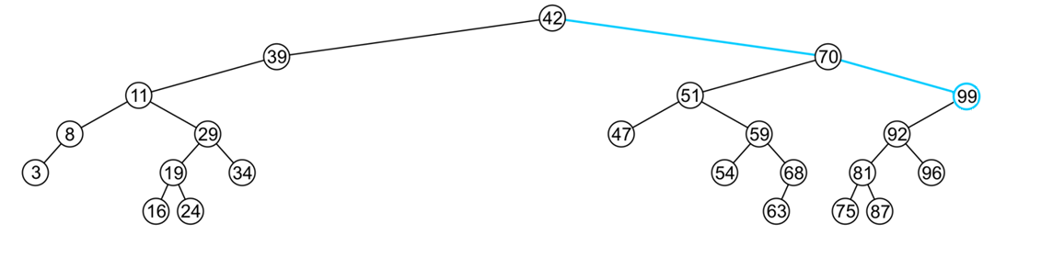
Finding the Max/Min Object
The run time O(h)
The extreme values (max/min) are not necessarily leaf nodes
Notes:
12

Slide 13
Binary Search Approximation
What is Binary Search Approximation? (Approximate binary search)
Given a set of keys and a sorted (non-decreasing) vector of values, use a binary search to find the indexes in values that match the values of key. This implementation allows for returning the index of the nearest match if there are no exact matches. It also allows specifying a tolerance for comparison of doubles.
Approximation in Binary Search:
Consider the children's game "guess a number." The scorer has a secret number, and will only tell the player if their guessed number is higher than, lower than, or equal to the secret number. The player then uses this information to guess a new number. But the upper bound and lower bound is not known.

Slide 14
Dictionaries

Slide 15
Dictionaries
Dictionaries store elements so that they can be located quickly using keys.
A dictionary may hold bank accounts
Account number
Current balance,
Details of account holder, and
Transaction History
Banking Operation by using account number as a search key

Slide 16
Example
Suppose we have a system which is associated with approximately 150 error conditions where
Each of which is identified by an 8-bit number from 0 to 255, and
When an identifier is received, a corresponding error-handling function must be called
We could create an array of 150 function pointers and to then call the appropriate function….
Unfortunately, this is slow—we would have to do some form of binary search in order to determine which of the 150 slots corresponds to,
for example, error-condition identifier id = 198
If there was a possibility of dynamically adding new error conditions or removing some error conditions, this would substantially increase the effort required…
A better solution:
Create an array of size 256
Is the increased speed worth the allocation of additional memory?

Slide 17
keys
Our goal:
Store data so that all operations are O(1) time
Use Array to store, and array index as the key to search
Use List to store, and Binary Search to search a key
Requirement:
The memory requirement should be O(n)
Solution:
Hashing

Slide 18
Hashing
A hash table is a data structure for storing a set of items, so that we can quickly determine whether an item is or is not in the set.
The process of mapping an object or a number onto an integer in a given range is called hashing
Problem: multiple objects may hash to the same value
Such an event is termed a collision
Hash tables use a hash function together with a mechanism for dealing with collisions
The ultimate goal is to map onto an integer range 0, 1, 2, ..., M – 1

Slide 19
Analysis of Hashing
An ideal hash function would pick a slot, uniformly at random and hash the key to it with No Collision.
However, this is not a hash function since we would not know which slot to look into when searching for a key.
For our analysis we will use this simple uniform hash function
If choosing a hash function uniformly at random, makes every hash value equally likely for every item in the universe
Given hash table T with m slots holding n elements, the load factor is defined as α=n/m
An good hash function is one which distributes keys evenly (Uniform Distribution) amongst the slots.
A “good” hash function minimizes the probability of collisions

Slide 20
Analysis of Hashing
Perfect Hashing
Perfect Hashing Guarantees NO COLLISION, but it requires that all the keys are known in advance and that there are relatively few of them.
Universal Hashing
If for any two items in the universe, the probability of collision is as small as possible.

Slide 21
Types of hash functions
We will look at two classes of hash functions
Predetermined hash functions (explicit)
The easiest solution is to give each object a unique number, For example:
an auto-incremented static member variable
All BITS Non Specific student have two hash values:
BITS ID Number
Employee ID Number
Arithmetic hash functions (implicit)
An arithmetic hash value is a deterministic function that is calculated from the relevant member variables of an object
Rational numbers, and
Strings
Hashing uses the numeric keys only.

Slide 22
The hash process
Object
32-bit integer
Modulus, mid-square, multiplicative, Fibonacci
Map to an index (0, ..., (M – 1))
Deal with collisions
Chained hash tables
Open addressing
Linear probing
Quadratic probing
Double hashing

Slide 23
Hash Function (revisited)
Need to choose a good hash function
Quick to compute
Deterministic (Regenerate the same hash, as of insert, while lookup)
Distributes keys uniformly throughout the table
Good hash functions are very rare–birthday paradox
Continuous (Neighbourhood Numbers are Hashed in Neighbourhood only)?
Non-Invertible (should not be able to, construct the original key from hash value)
How to deal with hashing non-integer keys:
Find some way of turning keys into integers
e.g. remove hyphen in 9635-8904 to get 96358904!
For a string, add up ASCII values of the characters of your string
Then use standard hash function on the integers

Slide 24
Popular Hash-Code Maps
Integer cast: for numeric types with 32 bits or less, we can reinterpret the bits of the number as an int
Component sum: for numeric types with more than 32 bits (e.g., long and double), we can add the 32-bit components.
Polynomial accumulation: for strings of a natural language, combine the character values (ASCII or Unicode) a₀a₁... a_{n-1} by viewing them as the coefficients of a polynomial: a₀+ a₁x+ ...+ x_{n-1}a^{n-1}
The polynomial is computed with Horner’s rule, ignoring overflows, at a fixed value x:
a₀+ x(a₁ +x(a₂+ ... x(a_{n-2}+ xa_{n-1}) ... ))
The choice x = 33, 37, 39, or 41 gives at most 6 collisions on a vocabulary of 50,000 English words

Slide 25
Compression Maps
Use the remainder
h(k) = k mod m, k is the key, m the size of the table
Need to choose m
m = b^{e}(bad)
if m is a power of 2, h(k) gives the e least significant bits of k
all keys with the same ending go to the same place
m prime(good)
helps ensure uniform distribution
primes not too close to exact powers of 2

Slide 26
Why Prime
Primes are unique numbers, the product of a prime with any other number has the best chance of being unique (not as unique as the prime itself of-course) due to the fact that a prime is used to compose it. This property is used in hashing functions.
If you choose a prime for the size of the table such a common factor is highly unlikely.
If the data is random then there’s no need for a prime number.
Used to keep collisions uniform when the population being hashed exhibits certain mathematical characteristics like being a multiple of a certain number e.g a population of all even numbers.

Slide 27
Why Prime
Concept of Equivalence Class??
“Every key in K that shares a common factor with the number of buckets m will be hashed to a bucket that is a multiple of this factor”
So what can be the solution?
We just have to minimize the number of common factors between m and the elements of K. That's why we have to use prime numbers because it has very few factors. A large prime number is the best solution.
Using prime number reduces the count of collisions, since highly frequent number won't have prime number as its multiple.
Picking a big enough, non-power-of-two number will make sure the hash function really is a function of all the input bits, rather than a subset of them.

Slide 28
Alternate to collision (Chaining)
Separate chaining
Each bucket is independent, and uses some Additional Secondary Data Structure (list of entries with the same index)
Link List
Self Balancing Binary Search Tree
Separate chaining with list head cells
Dynamic array
For separate-chaining, the worst-case scenario is when all entries are inserted into the same bucket
Chained hash tables also inherit the disadvantages of linked lists.

Slide 29
Alternate to collision (probing, double hashing)
Open Addressing
(The name "open addressing" refers to the fact that the location of the item is not determined by its hash value, and it does not uses Secondary Data Structure)
All elements are stored in the hash table, i.e., n ≤ m
Each table entry contains either an element or null
When searching for an element, systematically probe table slots
Modify hash function to take the probe number i as the second parameter
h: U X {0,1,2,……..m-1} -> {0,1,2,……m-1}
Hash function, h, determines the sequence of slots examined for a given key
Probe sequence for a given key k given by
<h(k,0), h(k,1), h(k,2),……. h(k,m-1)> - a permutation <0,1,…m-1>

Slide 30
Linear Probing
If the current location is used, try the next table location LinearProbingInsert(k)
if(tableisfull)error
probe=h(k)
while(table[probe]occupied)
probe=(probe+1)mod m
table[probe]=k
Uses less memory than chaining as one does not have to store all those links
Slower than chaining since one might have to walk along the table for a long time

Slide 31
Linear Probing
h(k) = k mod 13
insert keys: 18 41 22 44 59 32 31 73
 |  | 18 | 41 | 22 | 44 | 59 | 32 | 31 | 73
 |  |  |  |  | 31
 |  |  |  |  |  |  |  | 73
 |  |  |  |  | 44 | 32
 |  | 41 |  |  | 18 | 44 | 59 | 32 | 22 | 31 | 73
0 | 1 | 2 | 3 | 4 | 5 | 6 | 7 | 8 | 9 | 10 | 11 | 12

